Slide 1
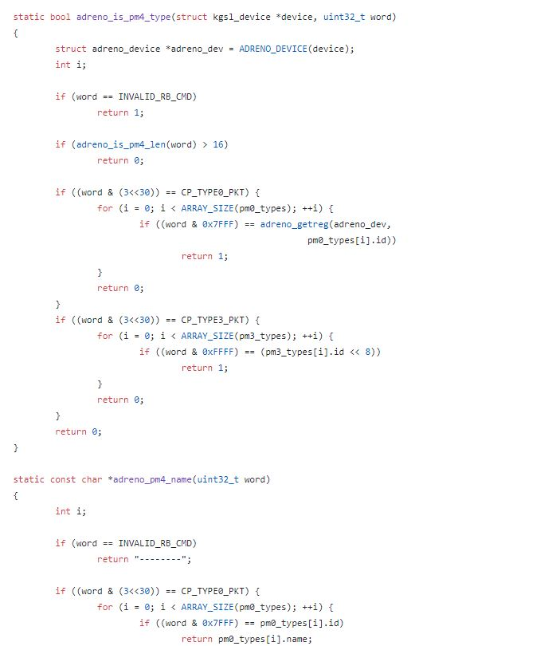
Code Review #1
05 - 최주원, 최운호, 최은솔, 최재강

Slide 2
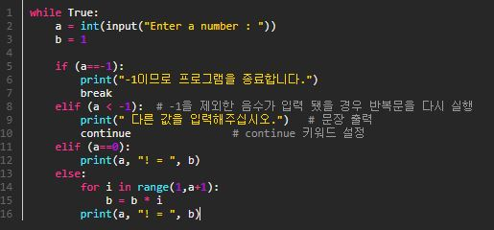
# 최운호_Code Review(Before)
Used Color Scripter™

Slide 3
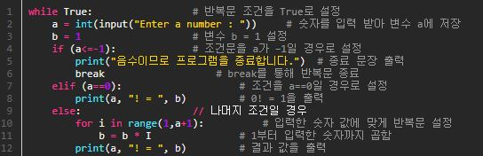
# 최운호_Code Review(After)
Used Color Scripter™

Slide 4
# Improved Performance
` Before
` After

Slide 5
Thank you

